Slide 1
Google Play™ Store Analysis
Kyle and Mark Peterson

Slide 2
Our Questions
What age-group has the most activity on Google Play™?
Are free apps more popular than paid ones? If so, how much more popular?
How common are positive reviews on apps?
Does file size have an affect on how many people download an app?
Are people more likely to leave a negative review on an app they’ve paid for?
Which genre has the most/least apps?
Which genre is the most popular?
Which genre is the most/least successful?

Slide 3
The Data We’re working with
Over 10,000 data entries on multiple Google Play™ apps
Source: Kaggle.com user Lavanya Gupta
Information used: App names, categories, ratings, numbers of reviews, file sizes, numbers of installs, payment types, prices, and maturity ratings

Slide 4
Cleaning the data
Dropped additional columns of information we wouldn’t be using, such as update versions for each app
Dropped 1,475 rows of data which were lacking information
Dropped 1,640 rows of data with information not applicable to our tests, such as apps with file sizes that vary by device
Dropped 700 rows which contained duplicate information
Left with 7,026 rows of data after cleanup

Slide 6
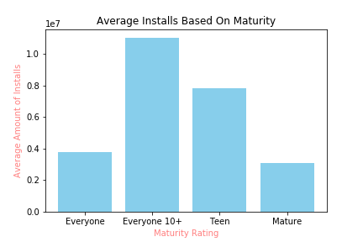
What age-group has the most activity on Google Play™?

Slide 7
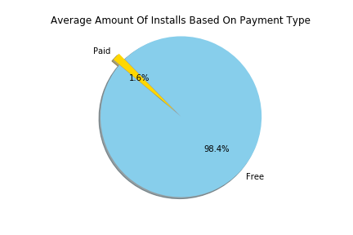
Are free apps more popular than paid ones? If so, how much more popular?

Slide 8
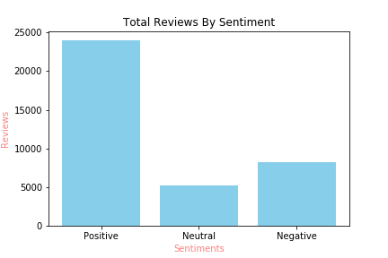
How common are positive reviews on apps?

Slide 9
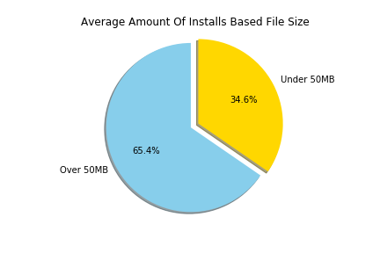
Does file size have an affect on how many people download an app?

Slide 10
Are people more likely to leave a negative review on an app they’ve paid for?

Slide 11
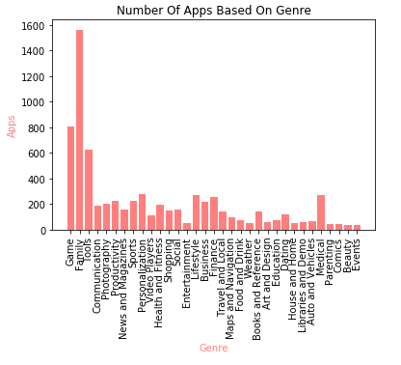
Which genre has the most/least apps?

Slide 12
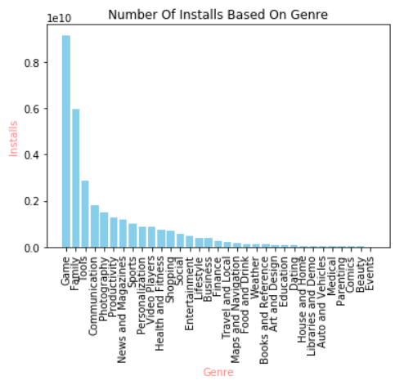
Which genre is the most popular?

Slide 13
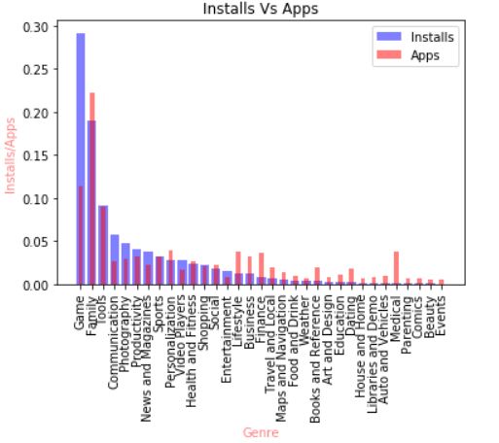
Which genre is the most/least successful?

